Slide 1
Biology
Unit 6: The Structure and Function of DNA
Lesson 1: DNA Structure and Replication
Notes:
Lesson Objective: Use evidence to evaluate claims about DNA as the molecule of inheritance and about the structure of DNA.

Slide 2

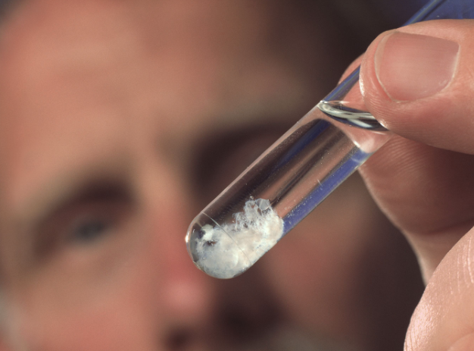
Can You Explain It?
Unit 6 Lesson 1
How can you make conclusions about something you cannot see?

Slide 3
The Function of DNA
Unit 6 Lesson 1
You have a set of traits, or distinguishing characteristics, such as hair color, eye color, face shape, and body type, that are passed from one generation to the next.
DNA, or deoxyribonucleic acid, is the molecule that stores the genetic information for all organisms.
DNA is heritable, which means it can be passed from parent to offspring.
Genetics is the study of biological inheritance patterns and variation in organisms.

Slide 4
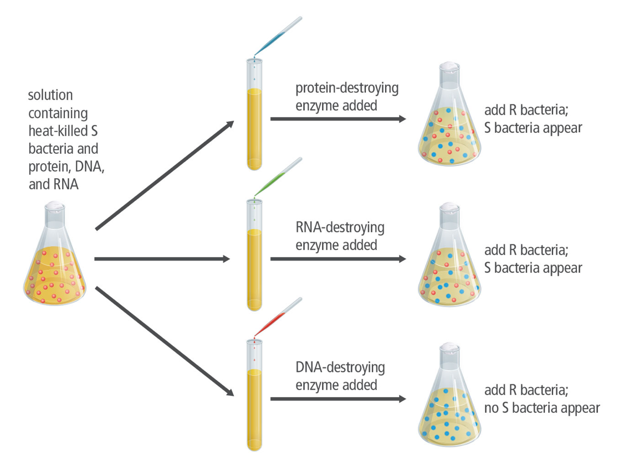
The Function of DNA
Unit 6 Lesson 1
Avery's Experimental Design

Slide 5
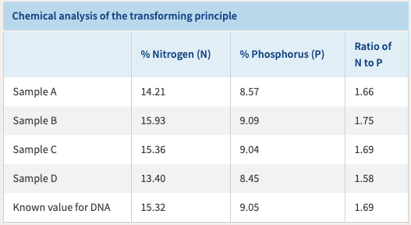
The Function of DNA
Unit 6 Lesson 1
How does the data in the table support the claim that DNA is the transforming principle?

Slide 6
The Function of DNA
Unit 6 Lesson 1
EXPLAIN
Draw a table to summarize each experiment. Include information on the relationship between the experiments, key data, and questions that remained after each experiment.
Develop an argument for why the data from each experiment either supported or did not support the conclusion that DNA is the molecule of inheritance.
Scientists often build on, and improve, the work of other scientists. This process may cover a long period of time. Explain how advances in technology affect this process of building scientific knowledge.

Slide 7
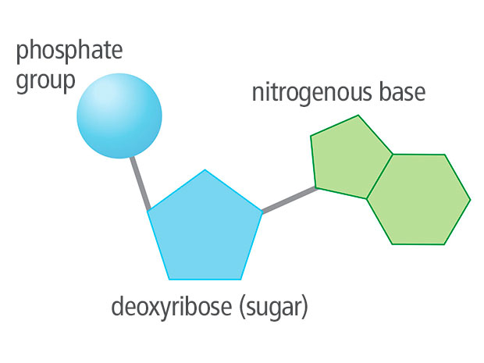
The Structure of DNA
Unit 6 Lesson 1
The subunit, or monomer, that makes up DNA is called a nucleotide.

Slide 8
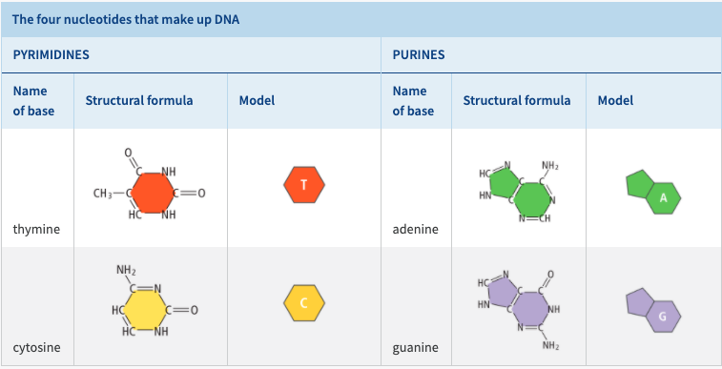
The Structure of DNA
Unit 6 Lesson 1

Slide 9
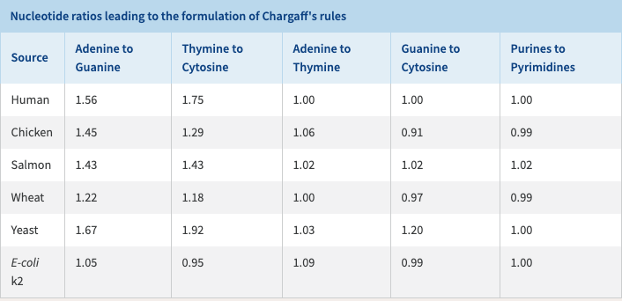
The Structure of DNA
Unit 6 Lesson 1
Chargaff found that the proportion of adenine, guanine, cytosine, and thymine varied from organism to organism. How does Chargaff's work support the idea that DNA is the molecule of inheritance?

Slide 10
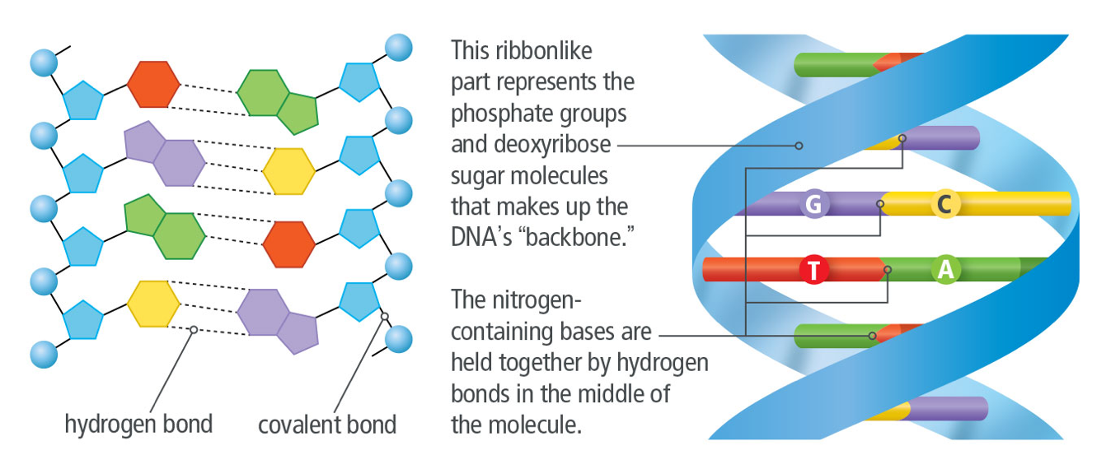
The Structure of DNA
Unit 6 Lesson 1
The current model represents DNA nucleotides of a single strand joined together by covalent bonds that connect the sugar of one nucleotide to the phosphate of the next nucleotide.

Slide 11
The Structure of DNA
Unit 6 Lesson 1
EXPLAIN
The current model represents DNA nucleotides of a single strand joined together by covalent bonds that connect the sugar of one nucleotide to the phosphate of the next nucleotide.

Slide 12
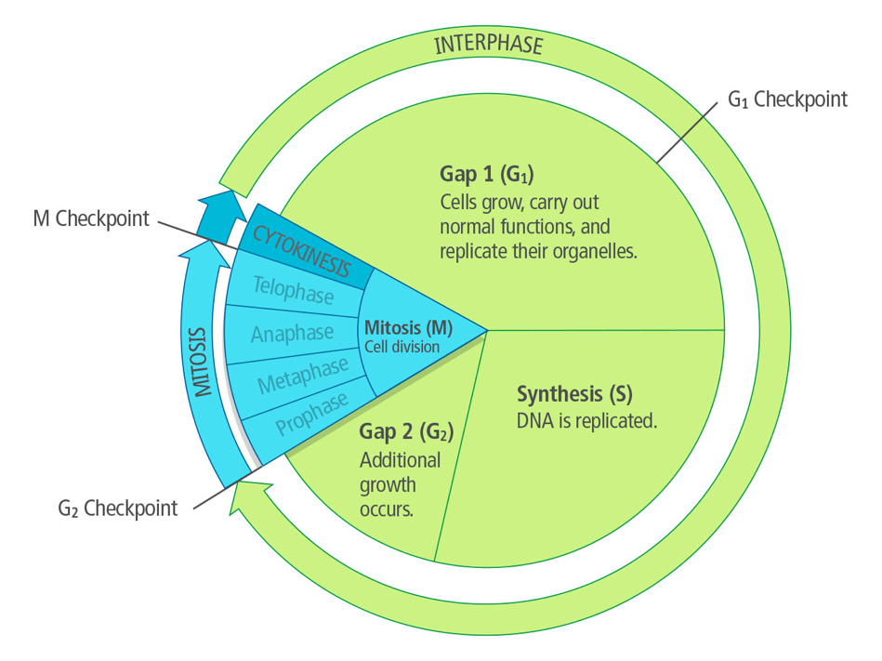
DNA Replication
Unit 6 Lesson 1
The process by which DNA is copied during the cell cycle is called replication.

Slide 13
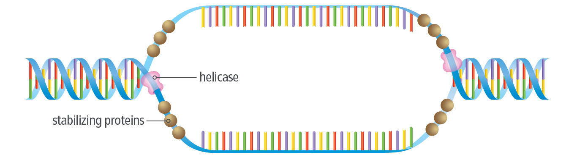
DNA Replication
Unit 6 Lesson 1
Some enzymes start the process by breaking the weak hydrogen bonds that hold the base pairs together.
A group of enzymes called DNA polymerases are involved in this process.
At the beginning of replication, an enzyme called helicase binds to the DNA molecule and unzips the strands.

Slide 14
DNA Replication
Unit 6 Lesson 1
EXPLAIN
Use an analogy to explain the sequence of events in the replication of DNA. Cite evidence from the diagram of DNA replication in detail to support your explanation.

Slide 15
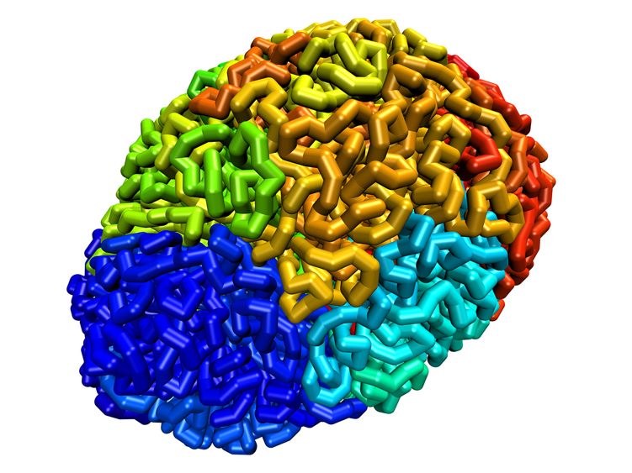
DNA Replication Engineering
Unit 6 Lesson 1
The Art of DNA Folding
Explain how advances in simulation technology have influenced scientists' understanding of DNA folding.

Slide 16
DNA Replication
Unit 6 Lesson 1
EXPLAIN
How does the structure of DNA aid in its replication?

Slide 17
Unit 6 Lesson 1
Continue Your Exploration
Choose one of the paths below to continue your exploration:
Extracting DNA
Telomeres and Aging
Evidence for DNA Structure and Function

Slide 18
Can You Explain It?
Unit 6 Lesson 1
Refer to the notes in your Evidence Notebook to explain how you would describe the structure of DNA. Use evidence and models to support your explanation, and address the following questions in your explanation:
How did the research of scientists such as Chargaff, Franklin, Watson, and Crick help advance our understanding of the structure of DNA?
What other methods can you think of that could be used to further study the structure of an object, such as DNA?

Slide 19
Image Credits
Unit 6 Lesson 1
Hooke's compound microscope ©Photo by SSPL/Getty Images; Hooke's sketches of cork cells ©Omikron/Science Source; fluorescent microscope ©Ted Kinsman/Science Source; telophase of mitosis ©University of Dundee/Dr. Paul Andrews/Science Source; melanoma ©Girand/Science Source; DNA sample ©Volker Steger/Science Source; DNA folding ©A. Sanborn and E.L. Aiden

